Slide 1
Indian Equity Markets – Forget The Past !
Nooresh Merani
www.analyseindia.com www.nooreshtech.co.in
August 8. 2012

Slide 2
What to Expect from this presentation…
We will be talking on –
Indices trend ( Sensex, Nifty and Bank Nifty ) in the past 2 years/ 5 years.
Global Indices trends.
The co-relation of Indian and Global Indices.
Nifty and India Vix co-relation.
Volumes on Nifty in recent Rallies and Crashes.
Impact Makers of Nifty 50.
8 and 13 year cycles on Sensex.

Slide 3
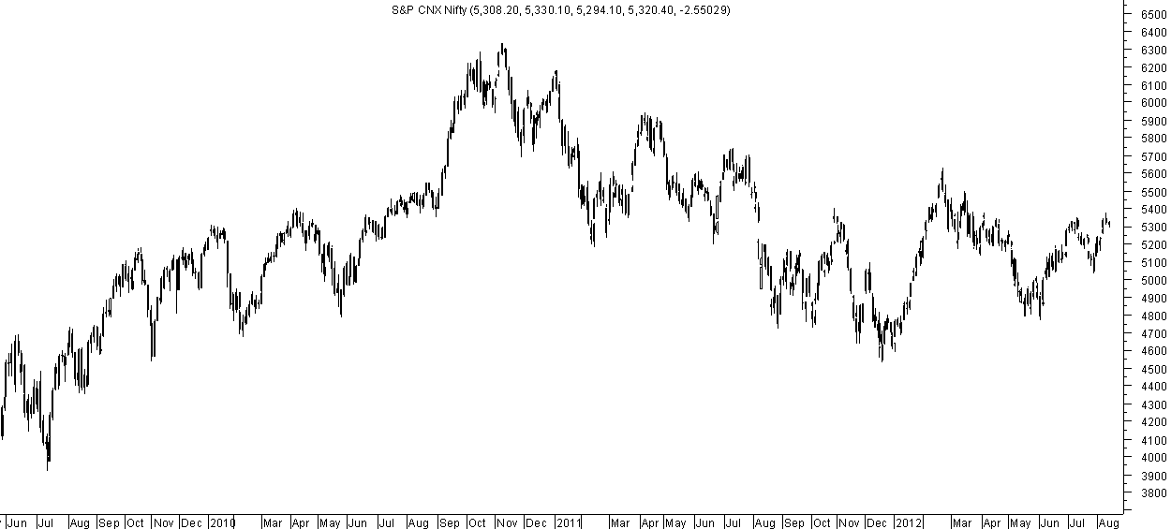
Nifty – Time spent at 4900-5350
Keeping volatility aside the Nifty has barely managed to stay in this band of 4900-5350

Slide 4
The Past - Range Bound Nifty in last 2 years
Since the big run in May 2009 Nifty has spent majority of the time at 4900-5350.
There have been sharp moves like the one in November 2010 to previous highs and similarly a dip to 4531 in December 2011.
S&P downgraded US in August 2011. Nifty was at 5200.
S&P downgraded India in June 2012. Nifty was at 5050-5100.
With various announcements, global events and triggers Nifty has basically found home in the band of 4900-5400 or rather in the mid of this range.
This we believe is going to change over the next few months.
Everyone has now ruled out any surprises for Nifty and the assumption is the range will be maintained.
Market moves the largest in the least expected direction.

Slide 5
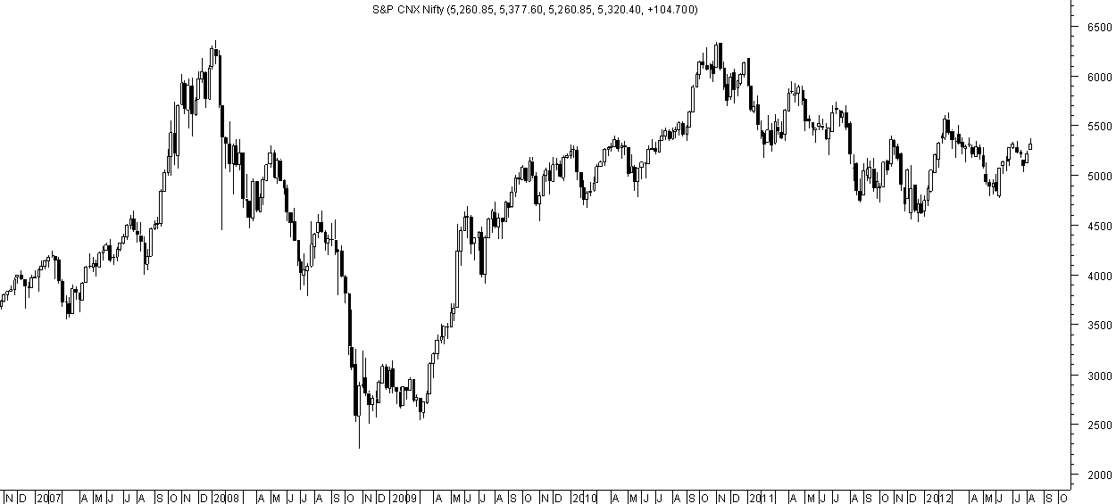
Nifty on a 5 year chart
In Sept 2007 we were at 5000 and we are almost at same levels in August 2012. Overall even on a 5 year frame we have spent more time around the 4900-5350 band.

Slide 6
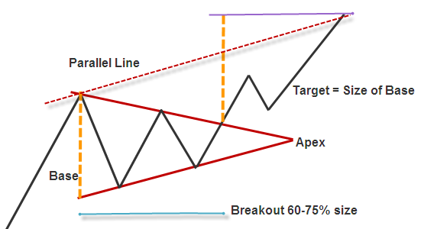
Symmetrical Triangle seen on Sensex/Nifty/Bank Nifty and Global Indices.
Such a triangle formation leads to a huge move on breakout.
Breakout is about to happen in many indices as all have completed 70% of the time in the triangle.

Slide 7
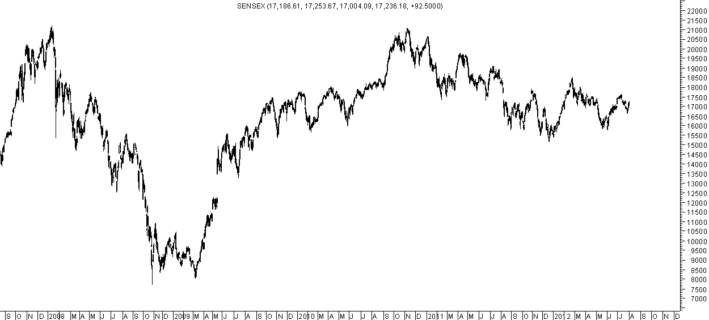
Sensex – Triangle on Daily chart
False Move/Double Bottom
Triangle Breakout above
17550-17650.
The contraction suggests it should be between August to October.

Slide 8
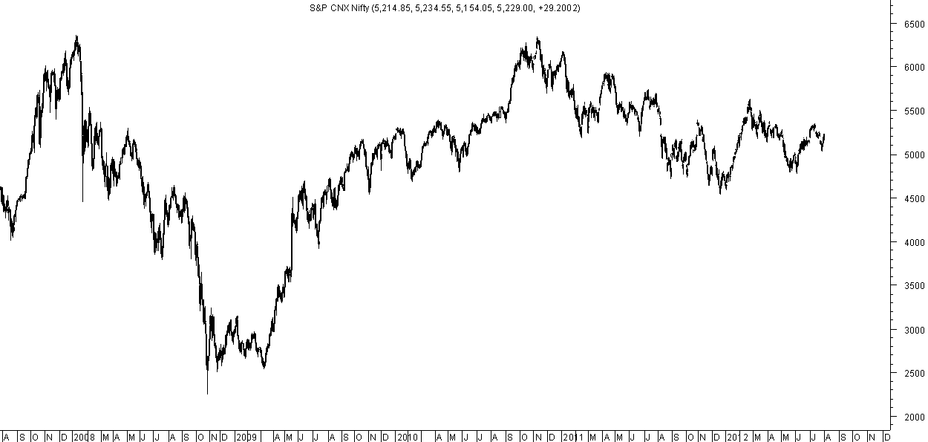
Nifty – Triangle on Daily Charts
False Move/Double Bottom
Triangle Breakout above
5350-5400.
The contraction suggests it should be between August to October.

Slide 9
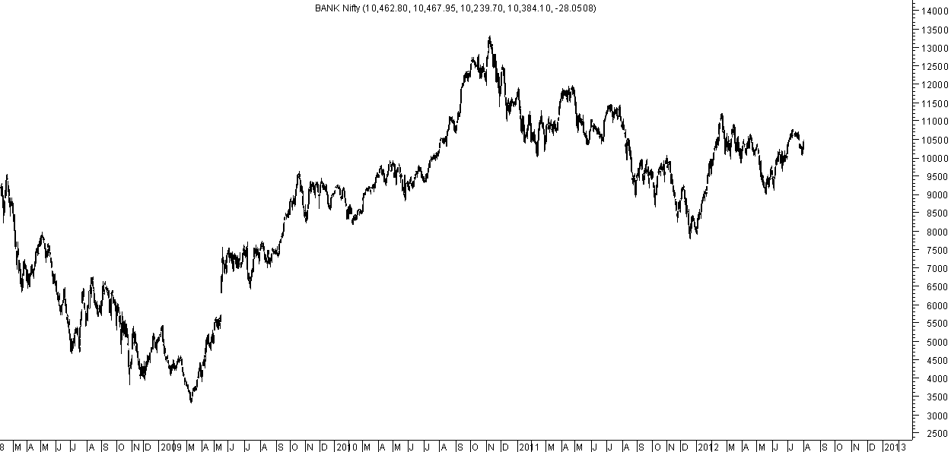
Bank Nifty – Breakout needs Momentum
First Attempt at breakout made. A move beyond 10900-11000 will give momentum. Range contracts suggest September to November.

Slide 10
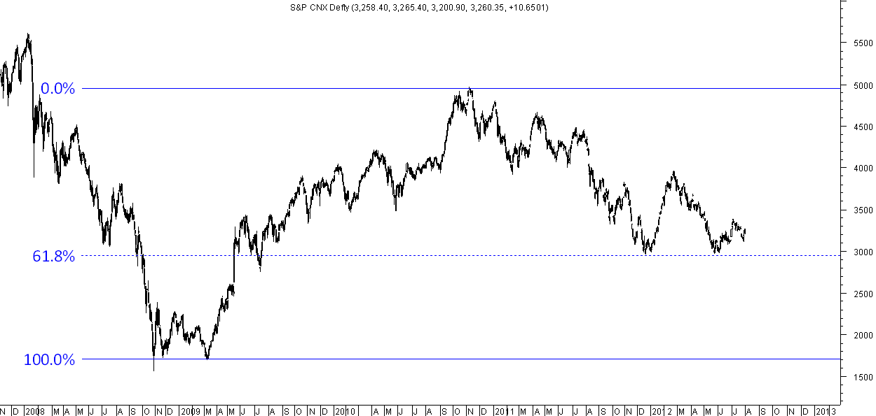
CNX Defty – Double Bottoms at 61.8% retracement
Double Bottoms at 61.8% retracement.

Slide 11
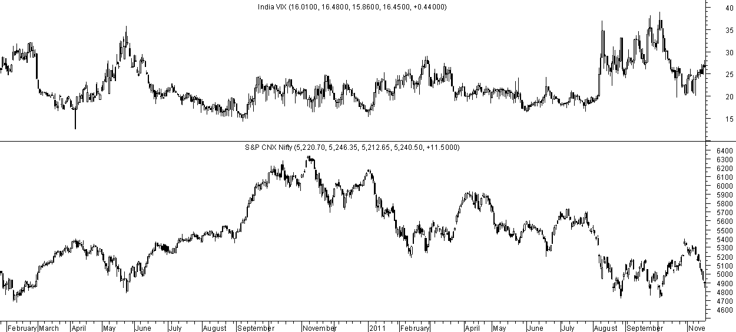
India Vix and Nifty Co-Relation -> September 2010
Volatilities continued to fall
Without a rally in Nifty.
VIX touched 40 and markets made panic bottom at 4700.
Huge Rally in Nifty with Rising Volatilities crushing Writers.
Volatilities continued to dip
Without a rally in Nifty

Slide 12
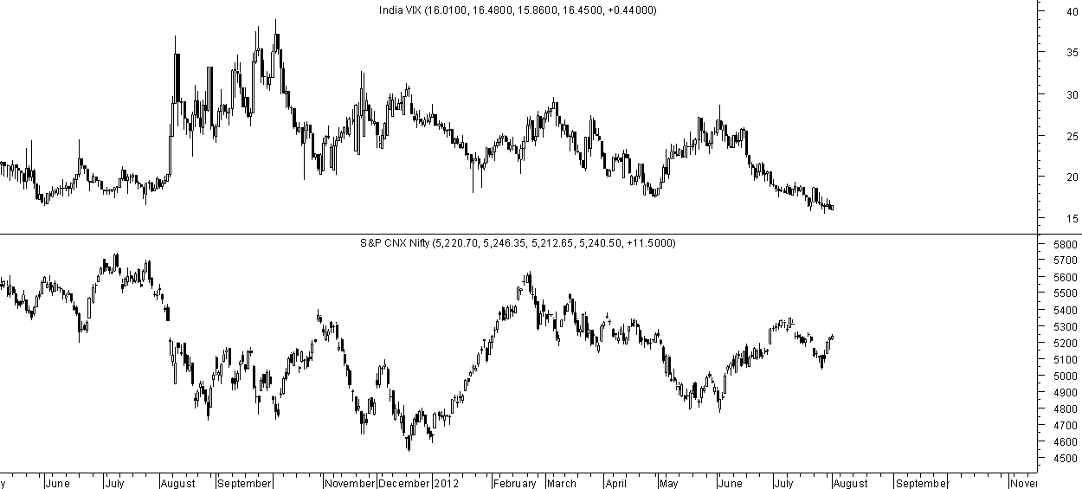
India Vix in 2011-2012
VIX has touched 14-15 levels with a range bound market. Indicating a directional breakout. Can it be similar to September 2010

Slide 13
RANGE BREAKOUT
This range of 5000-5400 will expand in the near future.
It’s a symmetrical triangle which can break on either side.
The triangle size is almost 500-1000 points which gives a big directional change of trend in coming months.
The apex of the triangle comes in November end so a breakout should ideally occur before it.
As the triangle compresses a breakout can occur any time between August 15 to October 15 giving a major directional breakout.
Critical points would be 5350-5400 and 4900-5020 for momentum.
Lets look why the probability on the UPSIDE Breakout is highest.

Slide 14
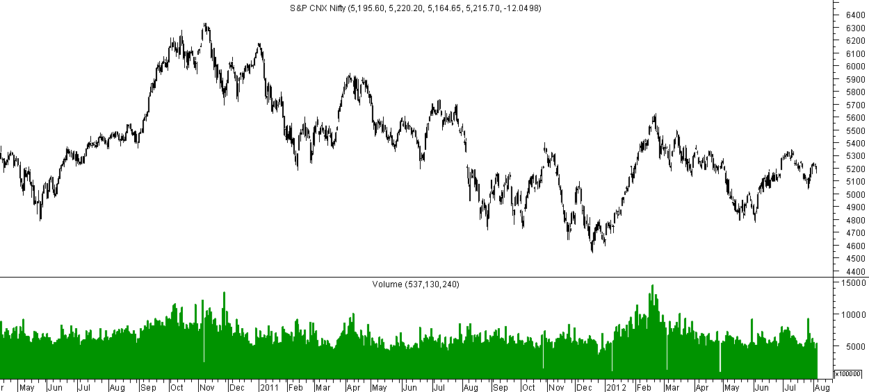
Nifty Volumes
Volume rise with fall in markets. Created a peak in 2010. A recovery to 5950 created hopes.
Rally of January with very high volumes created a bottom. A pullback to 4800 has created fear.

Slide 15
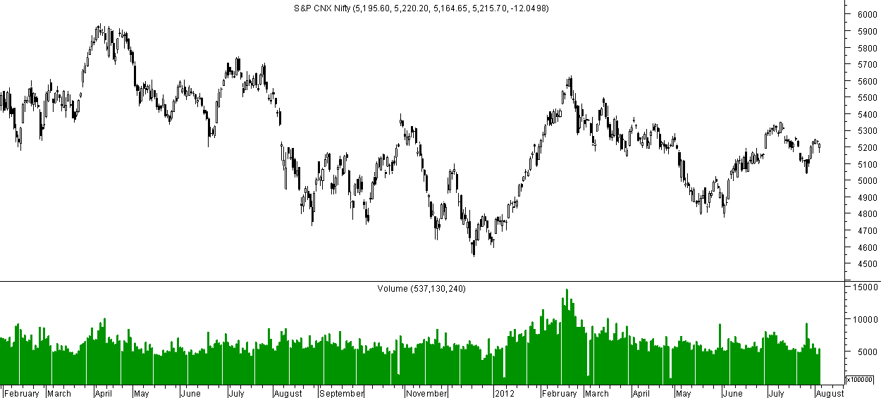
Falling Wedge Breakout
Falling Wedge Breakout creates long term bottoms.
A little break on downside

Slide 16
GLOBAL INDICES – Trend Remains Positive
Majority of the global markets made their bottoms in August to October 2011.
Quite a lot of markets are up 10-20% from those levels and have not re-tested their bottoms.
Indian Markets made a low little later in December 2011 and have underperformed from August lows to global markets.
The trend remains very positive for Global Markets though momentum seems to be slowing down but can catch up any time with the strong uptrend continuing.

Slide 17
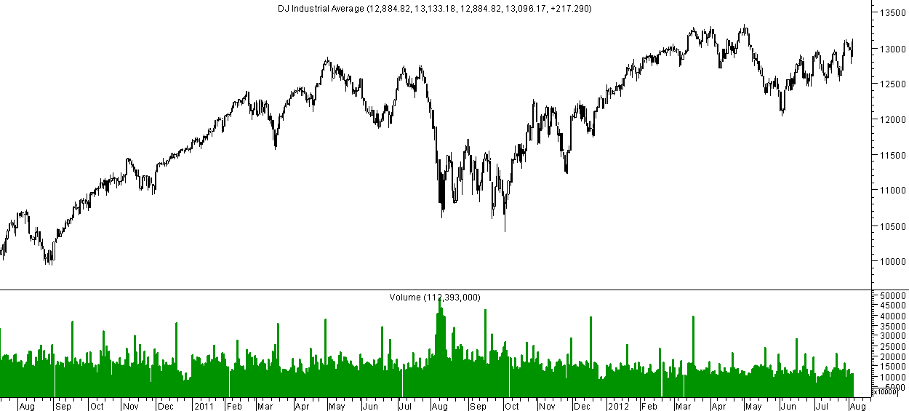
Dow Jones – Daily Chart
Higher Top Higher Bottom after testing breakout levels.
Not far from the 2012 highs.

Slide 18
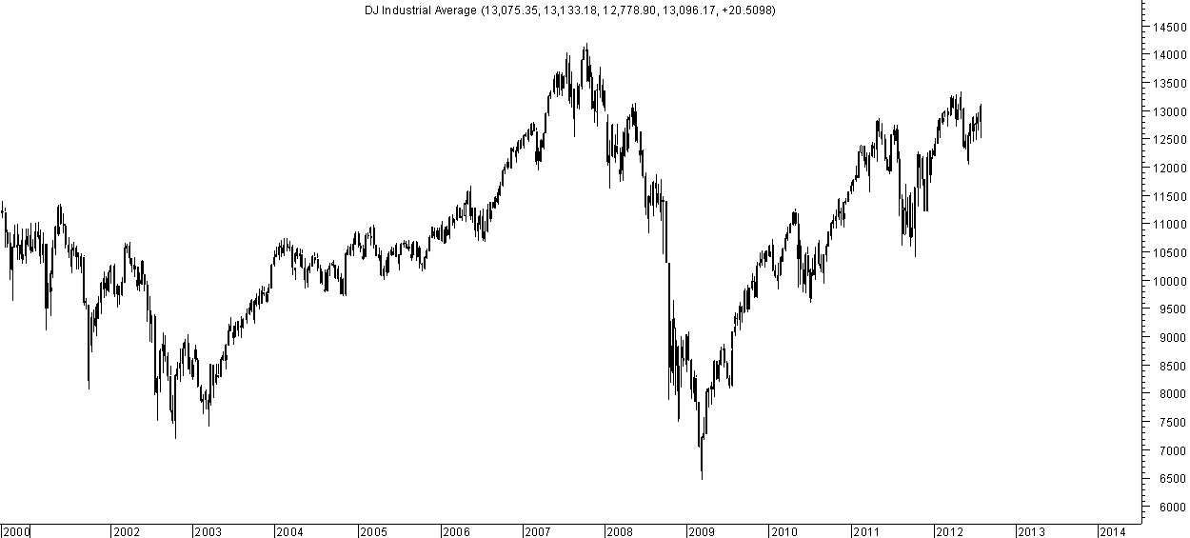
Dow Jones – Weekly Chart
Higher Top Higher Bottom continues with momentum. Move above 13350 will take it to 2008 highs.

Slide 19
Dow Jones – Taking Bears for a Ride Upside?
Fractal
Rally and Correction on break of trendline giving false hopes of big crashes.

Slide 20
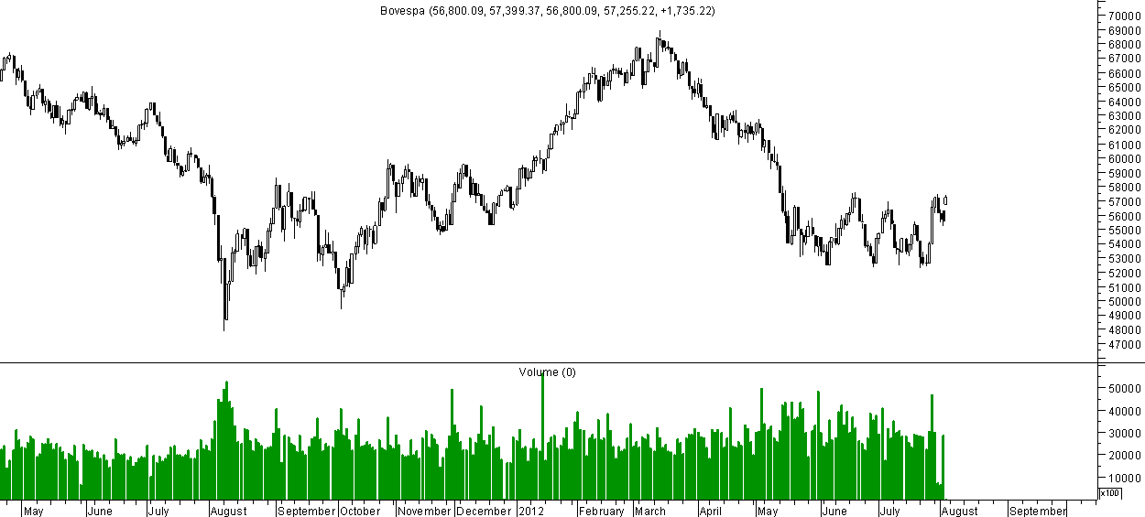
Bovespa – Setting for Short Term Breakout.
Multiple Bottoms and Channel Breakout on Cards.

Slide 21
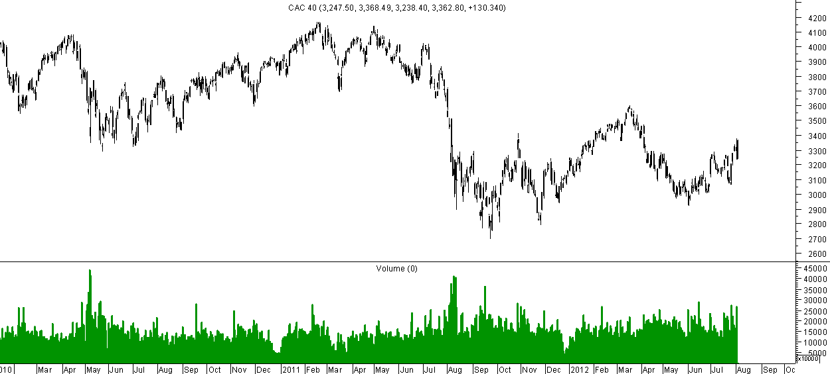
CAC 40 – Symmetrical Triangle – Waiting to Breakout
Symmetrical Triangle with
Higher Bottoms.

Slide 22
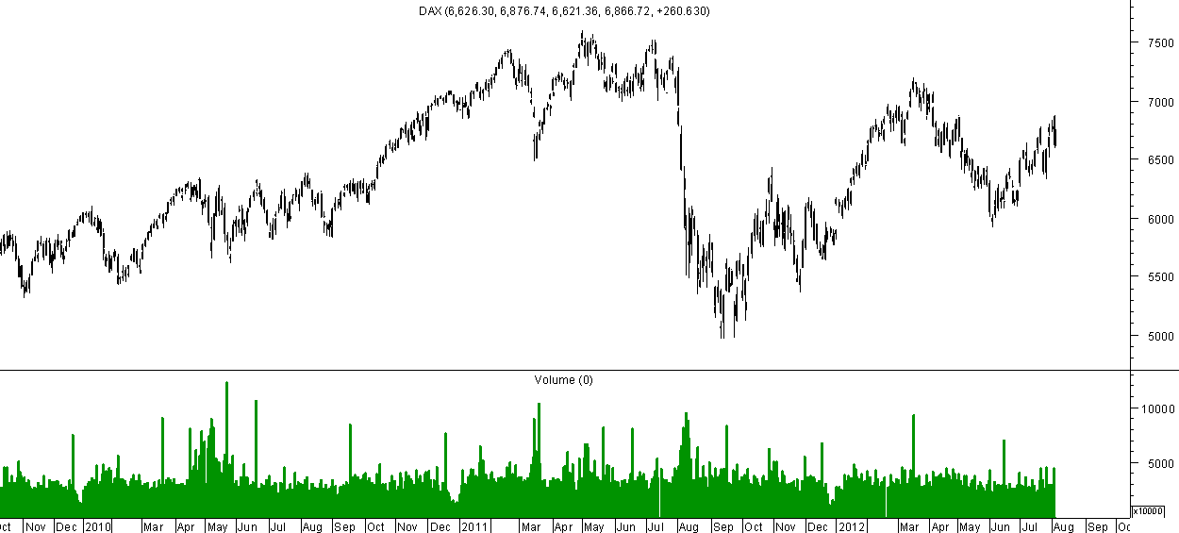
DAX –Trend remains positive but a new move above 7000
Symmetrical Triangle with
Higher Bottoms but breakout will
Take time.

Slide 23
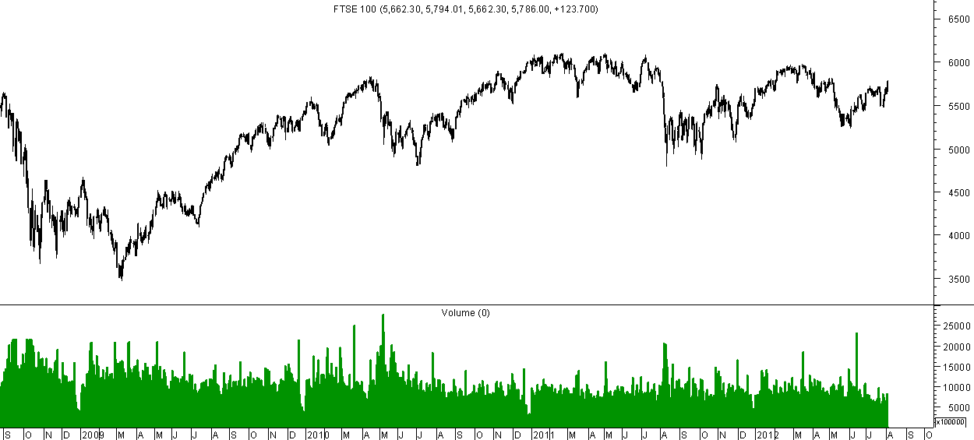
FTSE 100 – Range Bound
Symmetrical Triangle and a major resistance at 5900-6000. Trend remains positive.

Slide 24
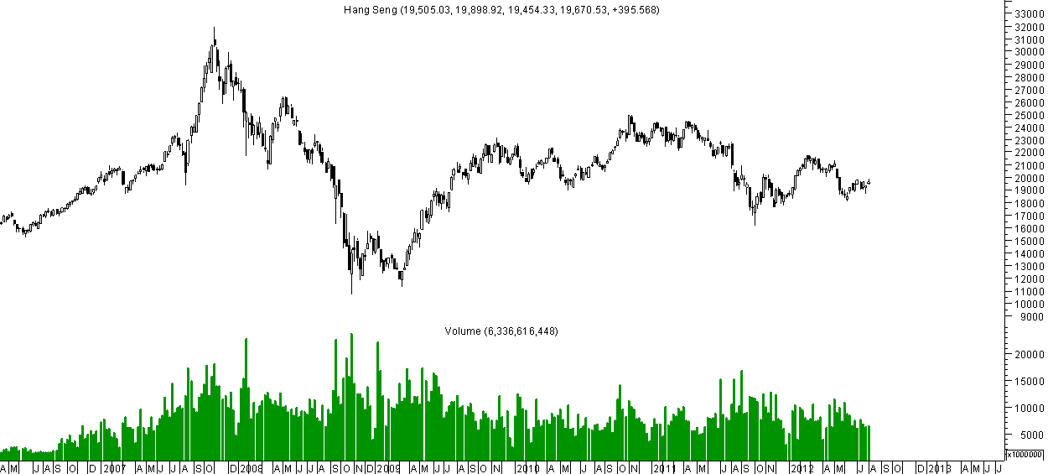
Hang Seng – Forming a triangle similar to Nifty
Symmetrical Triangle just like Nifty with apex around 2013.

Slide 25
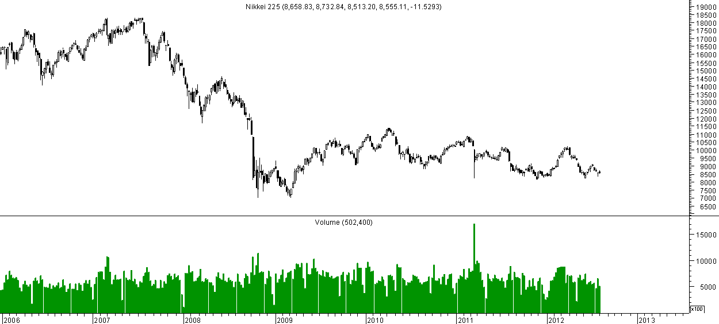
Nikkei – Range Bound Movement Continues.

Slide 26
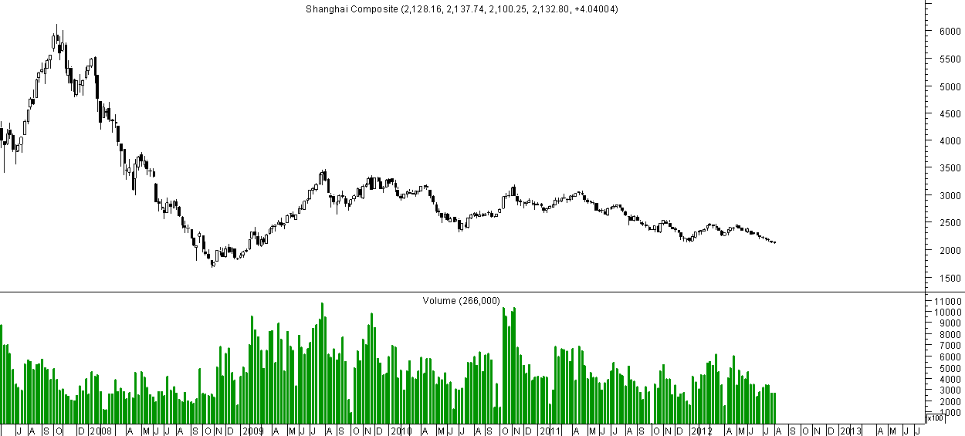
Shanghai – Symmetrical Triangle Breakdown Impact.
An example of what could happen if
a symmetrical breakdown.
No signs of bottoming out yet.

Slide 27
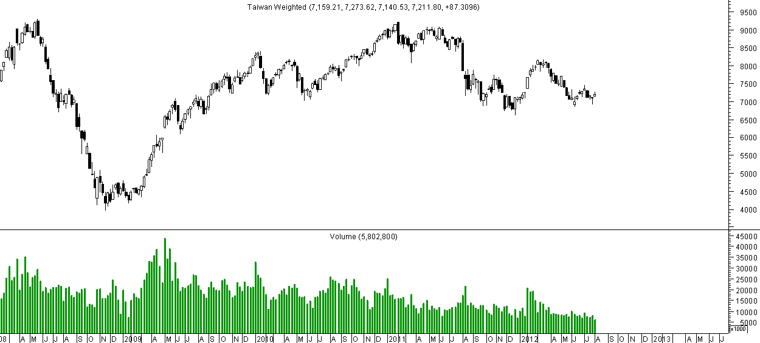
Taiwan – Making a base- Quite far from Breakout.

Slide 28
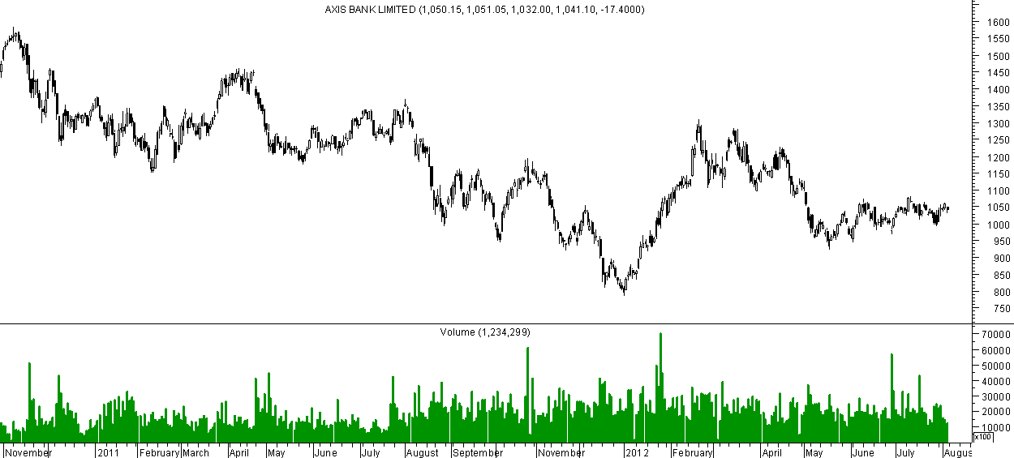
AXIS BANK – Triangle Formation.
1080 on upside is the trend change point and 970 on lower side. A break out of this range will give a 150-250 point move.

Slide 29
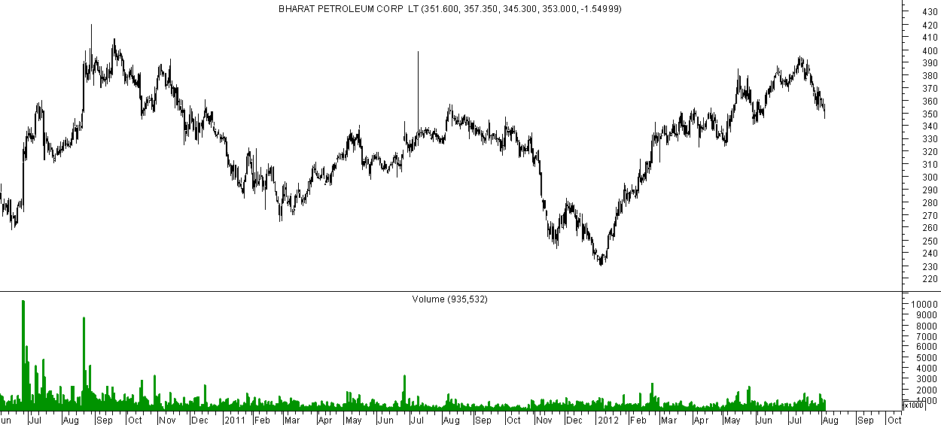
BPCL – Long Term Breakout being re-tested.
330-355 a strong support
Zone. Cup and Handle Breakout
Gives a target price of 400-450.

Slide 30
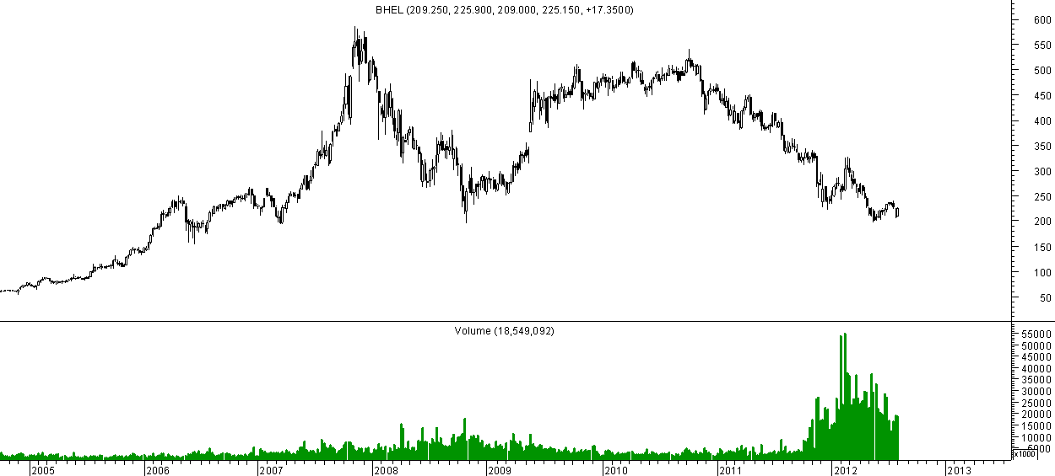
BHEL – At 5-7 year lows.
Major lows at 190-200 in last 5-7 years. Signs of Bottoming out.
Can accumulate with a stop of 190.

Slide 31
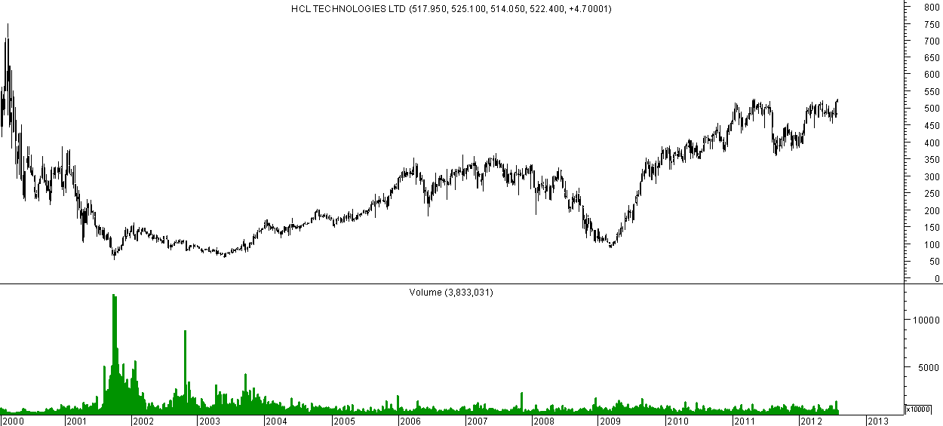
HCL TECH --- Future Leader of IT pack..
The breakout at 350 got it into a new range to 530. The next upside could take it to 650 in long term. Dips to 480-520 an accumulate area. Stop below 460.

Slide 32
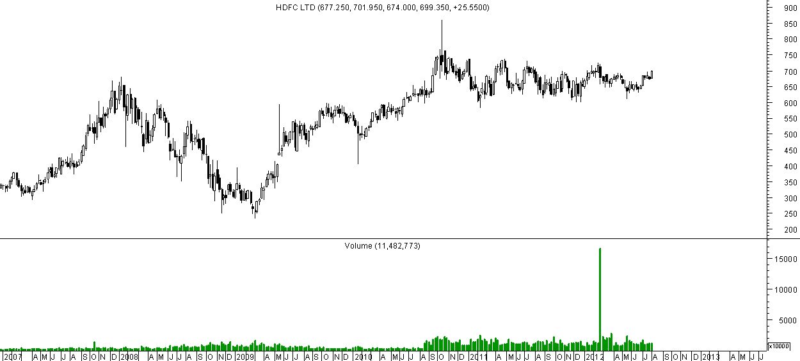
HDFC Limited – Range Bound between 630-735.
Good base built at 620-660. But upside resistance at 730. A move beyond that would Confirm a major breakout

Slide 33
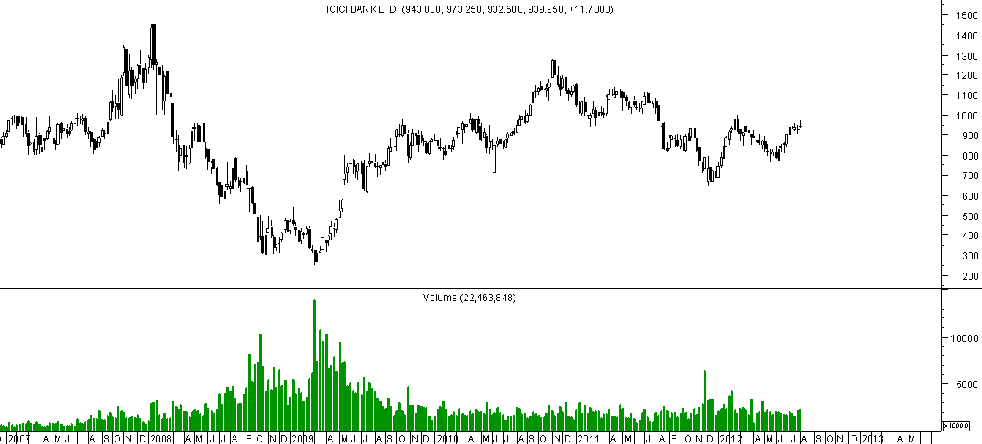
ICICI BANK – Breakout done, Buy on dips.
Triangle Breakout done and momentum above
1000 which is a critical resistance for long time.

Slide 34
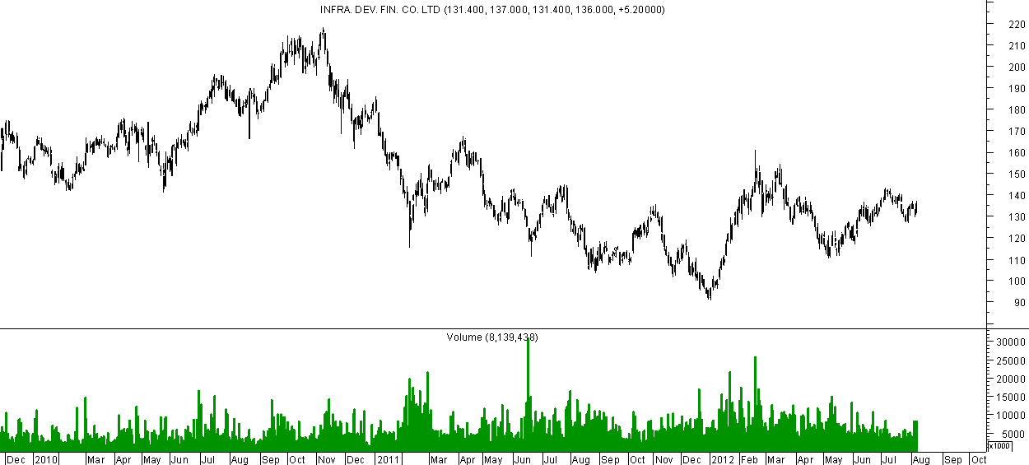
IDFC – Another triangle waiting to breakout.
Higher Top Higher Bottom with triangle breakout
Above 145 levels can give a move to 180.

Slide 35
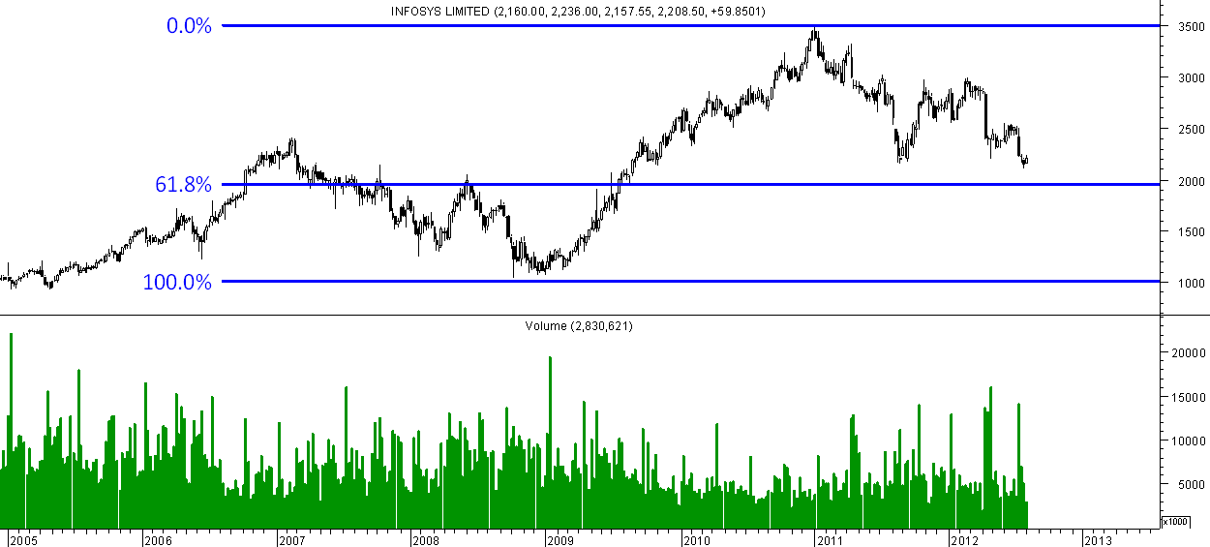
Infosys – Nearing 61.8% retracement.
61.8% retracement of entire move from 2009-2011
And top of 2050 in 2008 is a support zone. We can see some bottoming out formation in coming months.

Slide 36
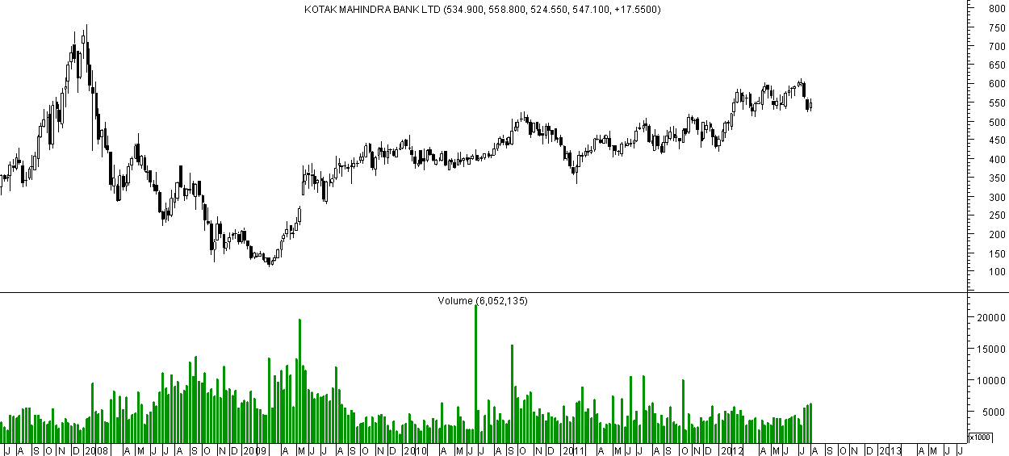
Kotak Mahindra Bank – At retest of Breakout.
Previous tops at 510-530 will act as a strong support. Long term upsides to 750 again. Accumulate on dips till 520 with a stoploss of 500.

Slide 37
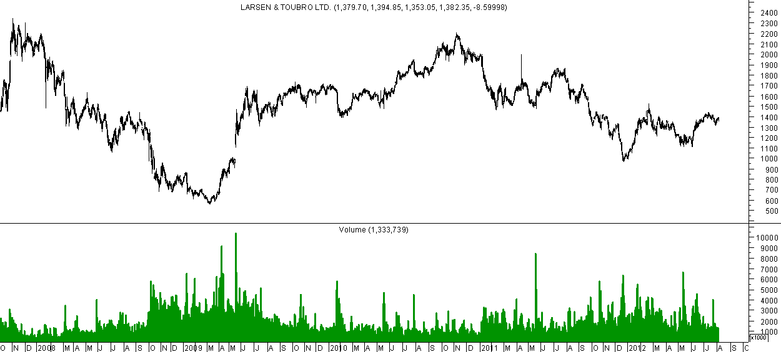
Larsen & Toubro – Momentum above 1450-1500.
Nice base made at 1100-1250. A new momentum upside will be seen above 1450-1500.

Slide 38
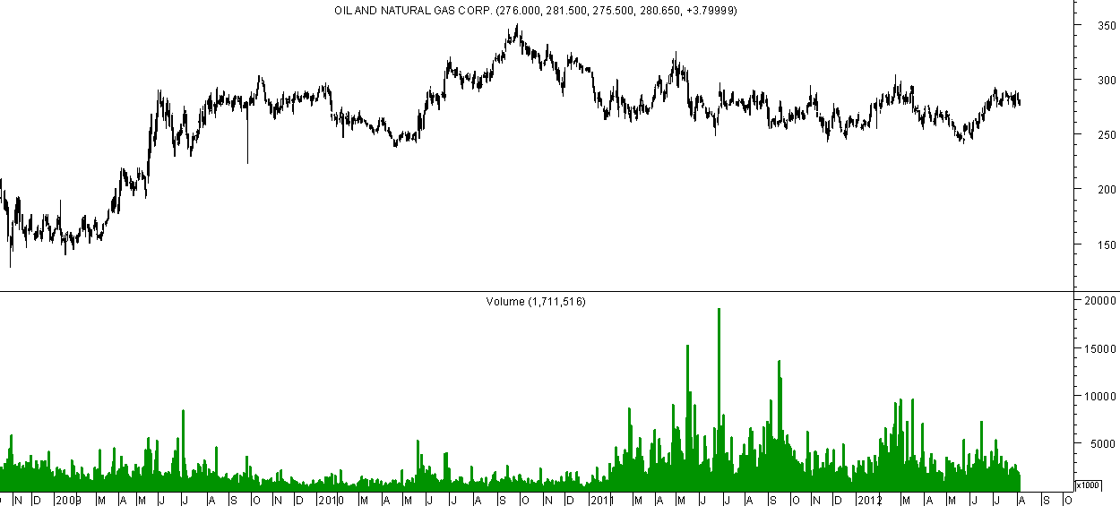
ONGC – Setting up for a Breakout.
With multiple bottoms on the lower band of 240-250. The next breakout should be above 295-300
Which can give a 15% jump.

Slide 39
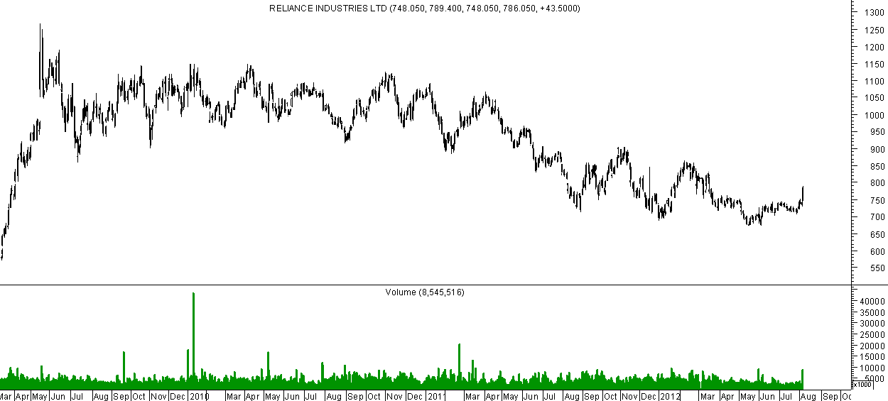
Reliance Inds – Falling Wedge Breakout
Bottom seems to be made at 670-700.
First indication of reversal would be on sustaining
750 and 780 on closing basis. Upside targets would be 900. Breakout expected in next 3 months.

Slide 40
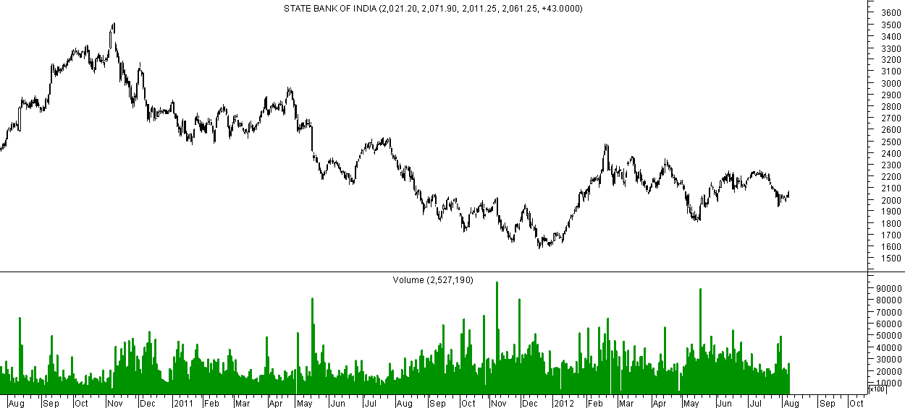
SBI – Holding the support line.
Still away from a breakout but till it holds
1850-1900 trend remains positive. Upside breakout can be seen above 2200 levels.

Slide 41
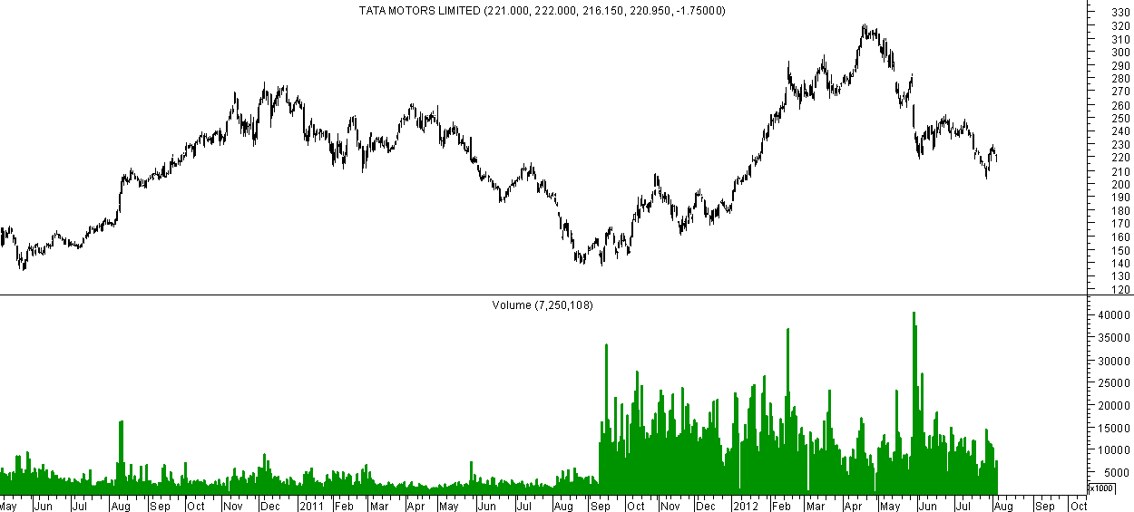
Tata Motors – Retesting Breakout Zones.
Cluster of supports at 195-220 which was the last
Major breakout point. We may see the stock back
to 270-300 in long term.

Slide 42
Blast from Past
The 13 year cycle presentation already in public domain from Analyse India since September 2005.
Wherein we had mentioned Sensex target at 44k/77k by 2018.
Another cycle is 8 years of scam and tops.
1992 – Harshad Mehta
2000 – Ketan Parekh
2008 – Ramalingam Raju/ Real Estate Bubble.
2016 - Top and Names ???
Before these peaks the last 3 years have seen major bull runs.
1989-1992, 1999-2001, 2005-2008.
In that case 2013-2016 should be the next Time cycle??

Slide 43
Sensex set for bull run till 2018 !!
Super Bull Run :
Dow Jones : 34 yrs
Sensex :13 yrs
Aug 2012
Aug 2009
Consolidation
Dow Jones : 17yrs
Sensex : 13 yrs

Slide 44
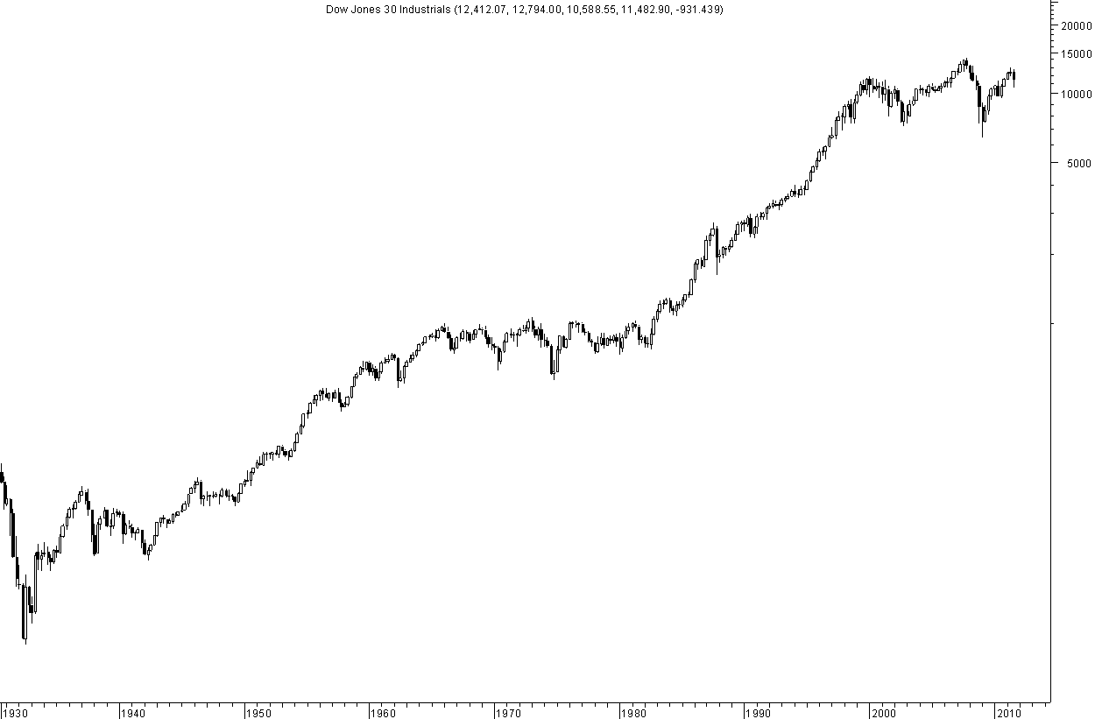
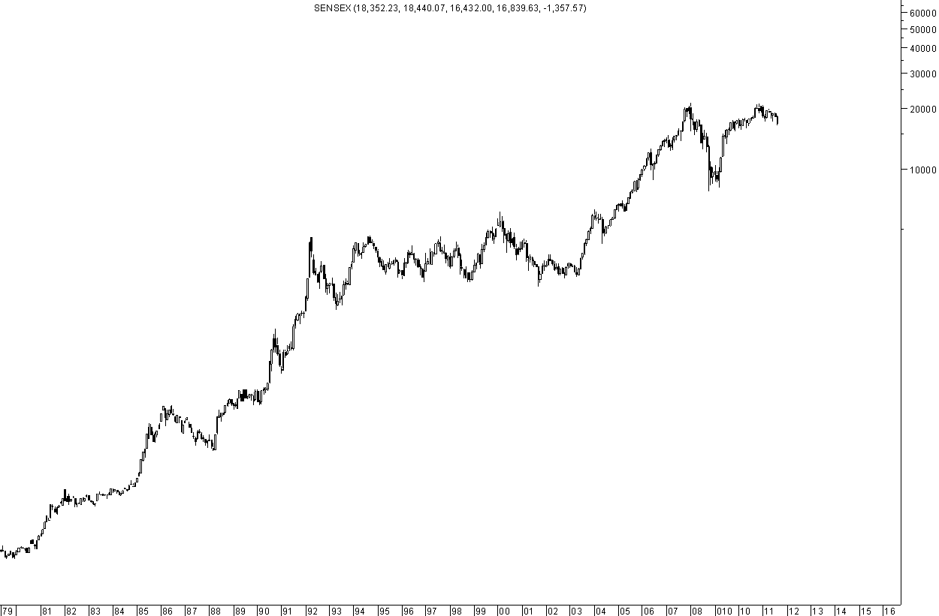
A terminal breakdown below the trendline before the big rally
A long parallel channel
Almost Double Bottom close to trendline
A terminal breakdown below the trendline before the big rally
A long parallel channel

Slide 45
Conclusion
Nifty/Sensex and Global Indices are setting up for a major directional move over the next 3-6 months.
The inflection point could be between mid August to November where a breakout has to come with contraction in the triangle patterns.
5350-5400 and 17650 are respective levels for Nifty/Sensex which will be breakout points.
On the downside a move below 4900 and 16000 are levels below which the positive view gets negated and would be our stoploss.
Upside target for such a move would be 500-700 points taking it to 5800-6200 band. 1500-2000 points on Sensex taking it to 19500-20000.
Banking, Financials, Oil and Gas could be the surprise bets for the upside.
We may expect major outperformance in midcap stocks which have not participated yet and the action could start in them right away.
In short – Forget the Past & blast ahead to a better future!!

Slide 46
Knowns
Greece is almost bankrupt. Italy and Spain next in line.
Yields for Spain and Italy have hit Euro era highs above 7 !
Germany 2 yr treasury notes going at negative yields. Many other countries having similar negative yields on 2 yr notes.
US treasury yields at their lower in last century.
US in a big debt problem and Europe continues to sink. ECB and Central Bank talking but no clear actions.
Crude at 110 brent with USD – INR sustaining 56 levels.
Current Account Deficit continues to bother.
Inflation showing no signs of slowing down big way.
Interest Rates continue to be high with less room for Repo rate cuts.
Policy Paralysis continues.
PSU Bank NPAs increasing with lot of restructured assets.
Trading Volumes in cash segment at 7 year lows.
AUMs of domestic funds shrinking with very low retail participation.
FIIs have still not started selling.

Slide 47
Unknowns
FDI in Retail, Insurance Sector Reforms.
Drop in Gold imports will impact CAD positively.
An uptick in economy will lead to recovery in PSU NPAs
Power Sector Reforms by the government.
Diesel Rate Hike.
Sovereign Dollar Bond.
GAAR revoked
Incentives for Equity Investment.
Government starts working.
Trailing 12 mths 14 times and 13 times 1 year forward P-E is below the mean.
Global Liquidity rush for risky assets.
Markets move on expectations rather than Actions !!

Slide 48
Feedback
To post your feedback click on the link below and get invited to a LIVE WEBINAR by Nooresh Merani
Feedback
Or copy this link on your browser.
https://docs.google.com/a/analyseindia.com/spreadsheet/viewform?fromEmail=true&formkey=dDhBSWdIS1NDU1lQVHN4U1dUeTNMYUE6MQ

Slide 49
Team Analyse India
Nooresh Merani
CEO - Analyse India
Cell: +91-9819225396
e-mail: nooreshtech@analyseindia.com
N S Fidai
Managing Director - Analyse India
Cell: +91-9920120878
e-mail: nsfidai@analyseindia.com
Ankit Chaudhary
Technical Analyst and Derivative Strategist - Analyse India
Cell: +91-9899899989
e-mail: ankit@analyseindia.com
Shamshuddin Daruwala
Technical Analyst - Analyse India
Cell: +91-9819919725
e-mail: shams@analyseindia.com

Slide 50
Disclaimer
As investment & trading consultants, Promoters, owners, families, relatives, friends and clients of www.nooreshtech.co.in maybe having positions in stocks / securities mentioned on the web site
All recommendations in this website are based on subject of Technical Analysis and do not reflect the fundamental validity of the stocks / securities. Authors / owners of Technical View by Nooresh will not be held responsible for any losses, financial or otherwise, incurred. To clarify, a ‘user’ is defined as anybody that visitshttp://www.nooreshtech.co.in, regardless of whether or not the have registered as a member of the website. ‘Site’ and the ‘community’ and‘www.nooreshtech.co.in’ are used interchangeably and refer to the URL http://www.nooreshtech.co.in and all sub-domains. The administrators and owners ofhttp://www.nooreshtech.co.in do not guarantee the reliability or completeness of any information provided on our site or in any hyperlink appearing on our site. Any advice or information presented on the site has not been verified by http://www.nooreshtech.co.in and does not represent the opinions of the same. Users of the site should not rely on the accuracy of any content on the site or assume any information they read on the site to be factual.http://www.nooreshtech.co.in, its administrators or owners will not be liable for any loss or damage caused by a user’s reliance on any information obtained from our site, or from a hyperlink found on our site. Members remain responsible for their own investments and should always conduct their own independent research before making independent investment decisions. If you choose to trade on the information, including but not limited to opinions or stock picks found on http://www.nooreshtech.co.in or any hyperlinks found on the site, then you have made a conscious, willing, free and personal decision to do so, and http://www.nooreshtech.co.in does not take any responsibility for this action.
By using http://www.nooreshtech.co.in you agree to be bound by the Terms and Conditions outlined below. If you don’t wish to be bound by the Terms and Conditions then do not complete this registration, and do not usehttp://www.nooreshtech.co.in or any of its associated services. We (the administrators and owners of http://www.nooreshtech.co.in) reserve the right to change these terms at any time, but will post a notice in advance on this website of any material changes. Following an update being posted, your continued use of http://www.nooreshtech.co.inimplies acceptance of the modified terms and conditions. All of the Content onhttp://www.nooreshtech.co.in remains the property ofhttp://www.nooreshtech.co.in. By “Content” we mean any information or materials found onhttp://www.nooreshtech.co.in. The harvesting of data from our site via automated means of any type, without the prior permission of http://www.nooreshtech.co.in is forbidden, as is attempting to access our site by any means other than through the interfaces we provide for accessing the site.

Slide 51
Disclaimer
You may make one copy of Content for your personal, non-commercial use as long as it is clearly labeled with “Intellectual Property of http://www.nooreshtech.co.in. All rights reserved”. Any other copying, distribution, storing, or transmission of any kind, or any commercial use of our Content, is prohibited without http://www.nooreshtech.co.in prior written permission. You may not republish, post, transmit or distribute Content to online bulletins or message boards, blogs, chat rooms, intranets or anywhere else without our consent. Notwithstanding the above, when you post Content, you do not surrender your copyright. You agree that http://www.nooreshtech.co.in a has an unlimited and perpetual license to republish the Content. However, you retain the right to use your words, images and other copyrightable content however you wish. We will always endeavor to ensure any content you publish is presented in context, and we’ll credit you (under your user name) as the author. We won’t republish your content in advertising without notifying you in advance and will not publish content in advertising if you instruct us not to.
As a member of http://www.nooreshtech.co.in , you agree to behave honestly at all times and act for the benefit of the users of the site. You, as a user of http://www.nooreshtech.co.in must not:
Post content that is not your own, or that is harmful, irrelevant, nonsensical, obscene, abusive, solicitous, fraudulent, or defamatory.
Misrepresent your true identity, motives and opinions
Take any action that places an unreasonable strain or disrupts the functioning of the site and its services
Copy the site’s content without prior permission from http://www.nooreshtech.co.in
Violate another member’s privacy
Violate any laws or regulations while using our site
If you don’t abide by the Code of Conduct, we will cancel your membership of the site.

Slide 52
Disclaimer
We collect information about who our members are and how they use our site in order to provide our members with the best experience possible. Sometimes we may use the information to notify you of products, services, specific content, or areas of our site that we think may interest you. You can choose whether or not to receive these notifications by altering your privacy settings at any time by contacting us at analyseindia@gmail.com Privacy whilst using the site When you post content onto our site, that information, along with your screen name, is visible to the public. Please remember that any information you disclose can be collected and used by others. Other members can respond to your posts at any time but will not know your external email address or other contact details (unless you have disclosed it).http://www.nooreshtech.co.in cannot guarantee the security of any information you transmit to us, and you do so at your own risk. You are responsible for maintaining the secrecy of any password and/or account information. We will never ask you for your password in an unsolicited phone call or email. If you are using a computer to which others have access, such as one in a computer lab, Internet cafe, or public library, always remember to log out and close your browser window when leaving our site. If you follow links from our site to others, you should be aware that you are doing business with those other sites, which have their own privacy and data collection practices. http://www.nooreshtech.co.in has no responsibility or liability for these sites.
Use of this site is subject to express Terms & Conditions, Code of Conduct, Privacy Policy, and Disclaimer. By continuing past this page, you agree to abide by these terms. Any information provided onhttp://www.nooreshtech.co.in should not be construed as research, trading picks or recommendations, or investment advice and is provided with no warrants as to its accuracy. Company names, products, services and branding cited herein may be trademarks or registered trademarks of their respective owners. The use of trademarks or service marks of another is not a representation that the other is affiliated with, sponsors, is sponsored by, endorses, or is endorsed by http://www.nooreshtech.co.in

